Slide 1
The Radar Musical Instrument
Josiah W. Smith

Slide 2

Hello!
Josiah Smith
BS Electrical Engineering – UT Dallas
Radar + machine learning research
2x senior capstone 1st place (team leader)
3 years start to finish
PhD Electrical Engineering – UT Dallas
Signal processing + hybrid algorithms
Radar imaging, tracking, localization
3 years start to finish
Industry Experience
Texas Instruments Research
IMEC Research
Apple
Ecuador with my wife Morgan

Slide 3
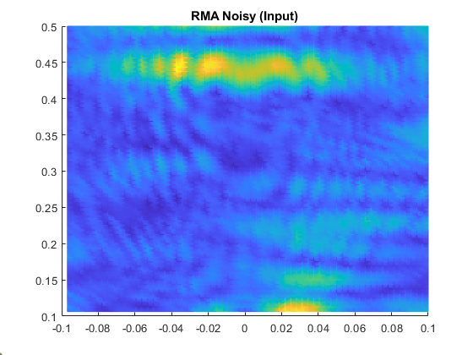

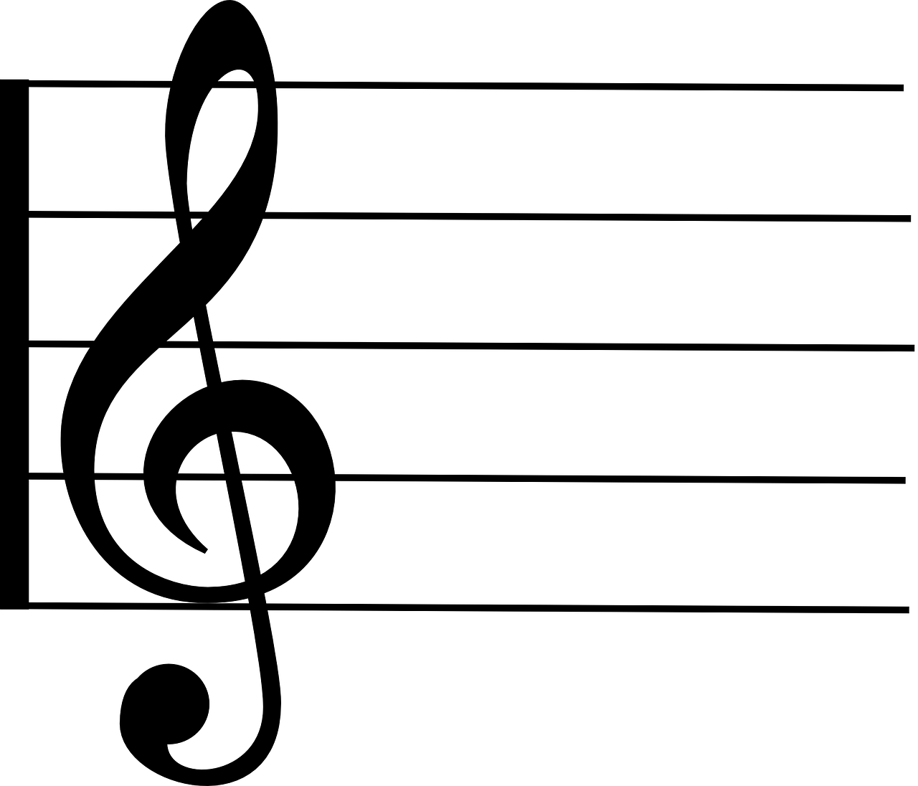
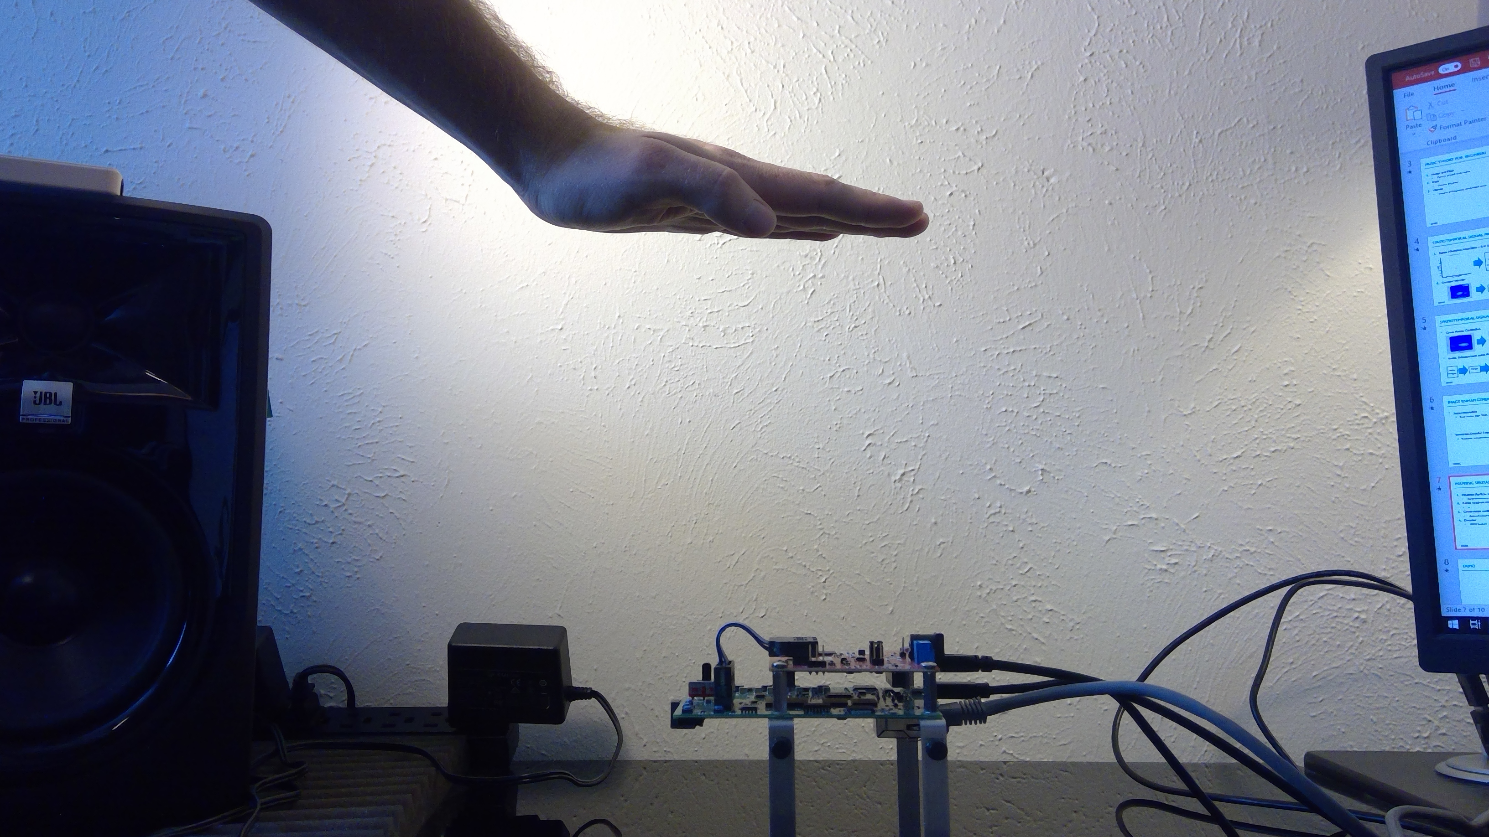
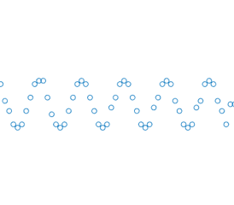
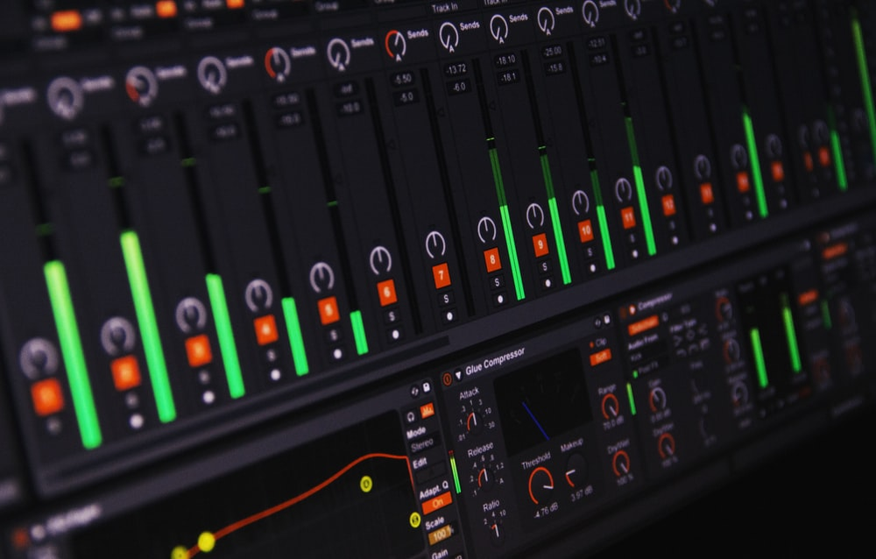

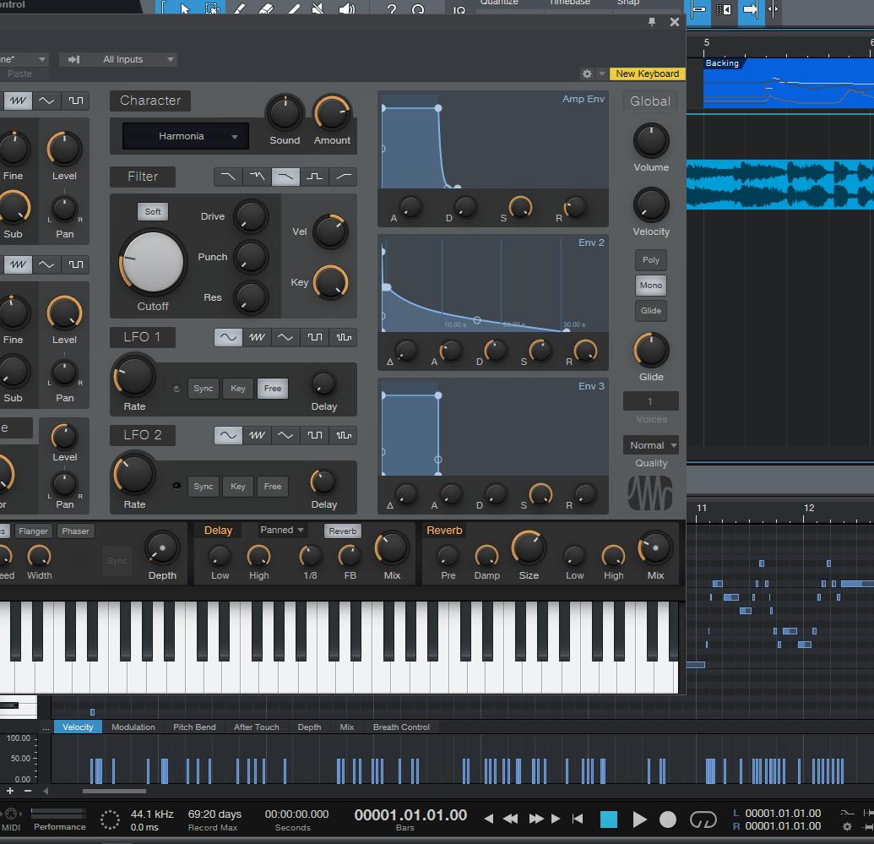
Radar Musical Instrument – Outline
Radar Signal Model for Musical Control
MIMO-FMCW mmWave Radar
Conventional Feature Extraction
Range, Cross-range, Doppler Signatures
Mapping Spatial and Temporal Features to Music
Enhanced Feature Extraction & Tracking
Image-to-Image Super-Resolution Neural Processor
Doppler-Corroborated Particle Filter

Slide 4
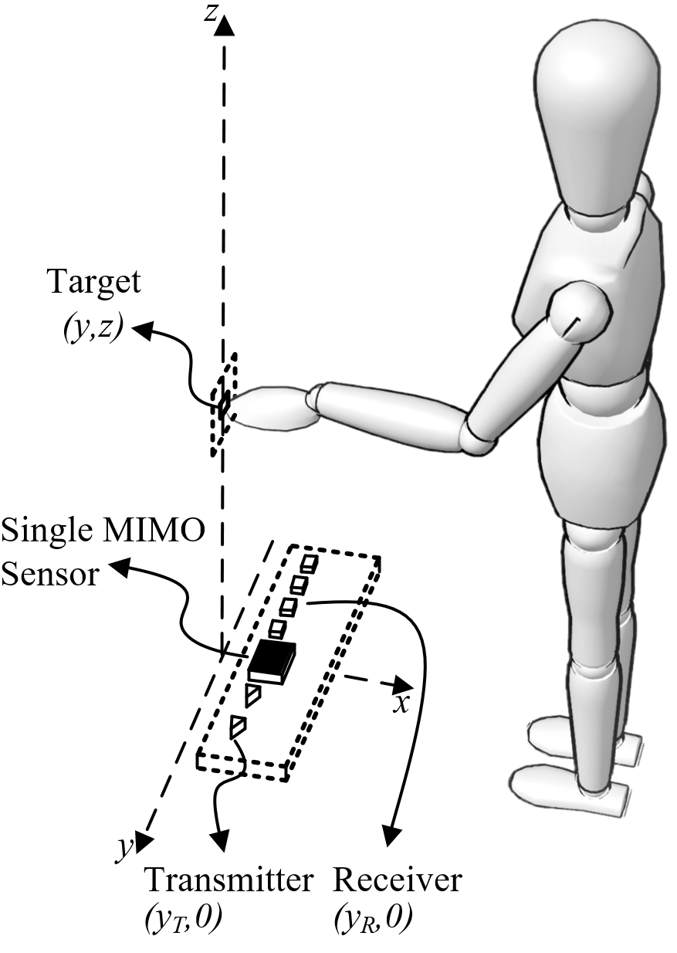
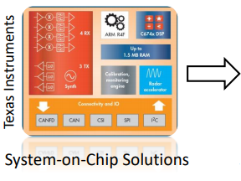
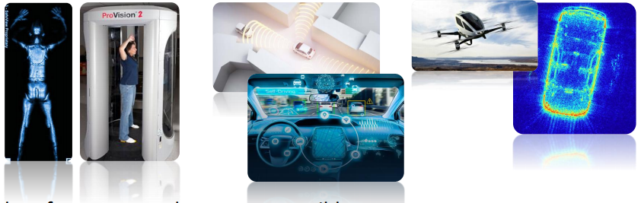
Introduction / Motivation
Low-cost millimeter-wave (mmWave) radar has a host of applications from commercial sensing, security screening, medical imaging, and human-computer interaction
Problem Statement: leverage the richness of the mmWave return signal to create an efficient, high spatial-resolution framework for precise human-computer interaction and digital instrument control.
Prior work:
Camera, RGB+D camera, camera + radar systems, Theremin
Issues: spatial resolution, privacy

Slide 5
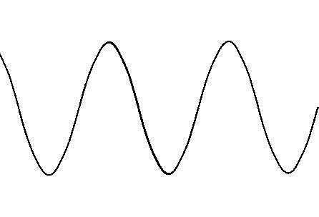
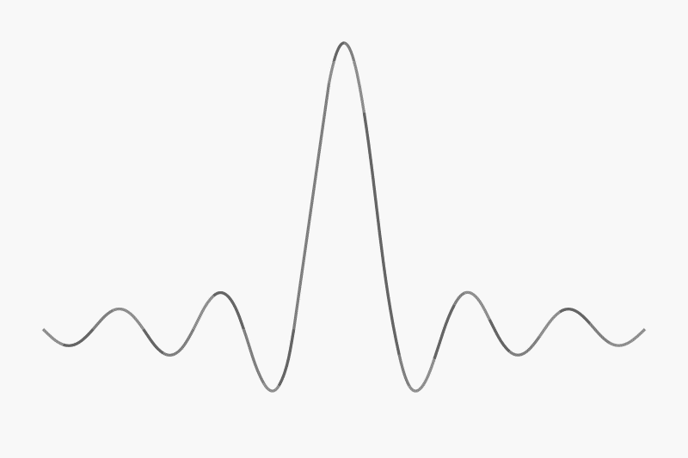
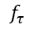
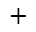
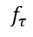
Frequency-Modulated-Continuous-Wave Radar
f
Tx Chirp
Transmit linear FM chirp
t
Demodulate to obtain IF signal
Target
f
f
Tx Chirp
Rx Chirp
$$−$$
IF Signal
$$f_{τ}$$
$$+$$
Receive time-delayed version of Tx signal
t
$$f_{τ}$$
t
$$τ$$
$$τ$$
Frequency contains spatial information
IF Signal
t
Fourier Transform
f
$$f_{τ}$$

Slide 6
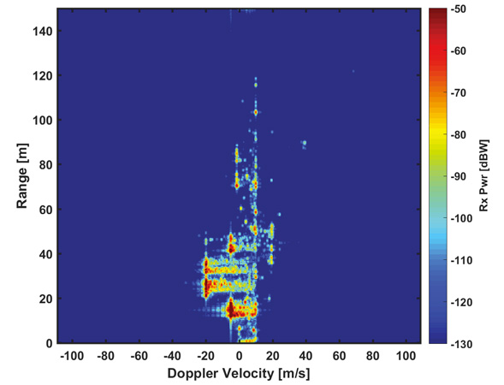
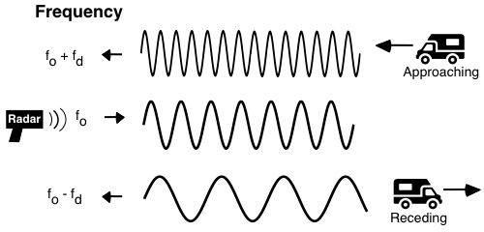
Doppler Radar
Doppler Effect
FFT across multiple FMCW pulses
Sensing distance: < 1 m
Goal: 3-D x-y-z localization
Issue: efficient MIMO near-field image reconstruction
Range-Doppler is not enough

Slide 7
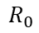
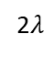
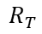
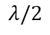
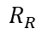
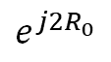
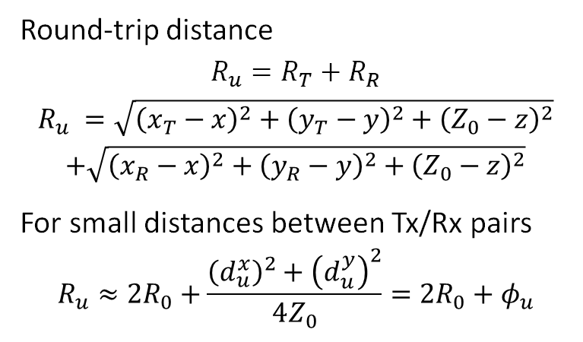
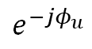
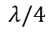
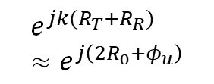
Multistatic-to-Monostatic Compensation
Round-trip distance
$$R_{u}=R_{T}+R_{R}$$
$$R_{u} =\sqrt{{\left(x_{T}−x\right)}^{2}+{\left(y_{T}−y\right)}^{2}+{\left(Z_{0}−z\right)}^{2}}$$
$$+\sqrt{{\left(x_{R}−x\right)}^{2}+{\left(y_{R}−y\right)}^{2}+{\left(Z_{0}−z\right)}^{2}}$$
For small distances between Tx/Rx pairs
$$R_{u}≈2R_{0}+\frac{{\left(d_{u}^{x}\right)}^{2}+{\left(d_{u}^{y}\right)}^{2}}{4Z_{0}}={2R}_{0}+φ_{u}$$
2$λ$
$$λ/2$$
MIMO Array
Virtual Array
$$λ/4$$
Compensation Procedure
$$R_{R}$$
$$e^{−jφ_{u}}$$
$$R_{0}$$
Multistatic Data
Monostatic Data
$$R_{T}$$
$$e^{jk(R_{T}+R_{R})}≈e^{j\left(2R_{0}+φ_{u}\right)}$$
$$e^{j2R_{0}}$$

Slide 8
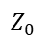
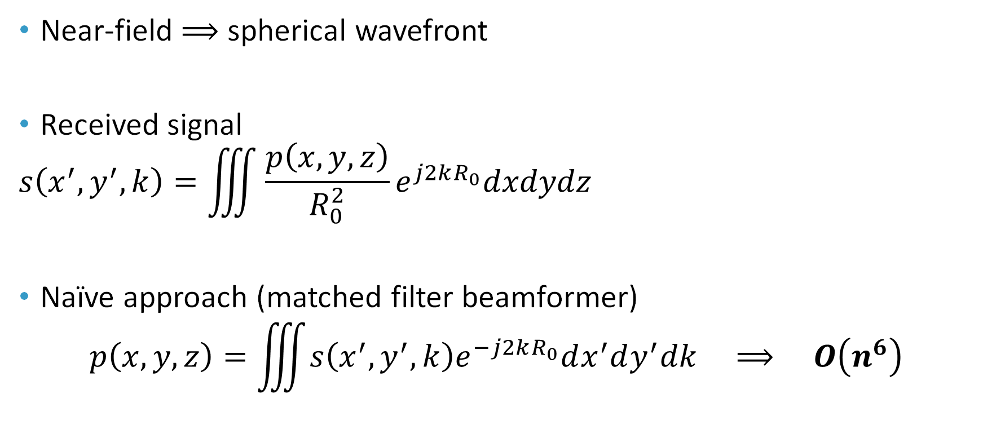
Efficient Near-Field Spatial Imaging
Near-field $⟹$ spherical wavefront
Received signal
$$s\left(x^{′},y^{′},k\right)=\iiint{\frac{p\left(x,y,z\right)}{R_{0}^{2}}}e^{j2kR_{0}}dxdydz$$
Naïve approach (matched filter beamformer)
$$p\left(x,y,z\right)=\iiint{s\left(x^{′},y^{′},k\right)e^{−j2kR_{0}}dx^{′}dy^{′}dk} ⟹ O\left(n^{6}\right)$$
Target
y
Tx/Rx
z
$$Z_{0}$$

Slide 9

Efficient Near-Field Spatial Imaging
Near-field $⟹$ spherical wavefront
Received signal
$$s\left(x^{′},y^{′},k\right)=\iiint{\frac{p\left(x,y,z\right)}{R_{0}^{2}}}e^{j2kR_{0}}dxdydz$$
Efficient approach – key step
$$\frac{e^{j2kR_{0}}}{R_{0}}≈\iint{\frac{e^{j\left(k_{x}\left(x^{′}−x\right)+k_{y}\left(y^{′}−y\right)+k_{z}Z_{0}\right)}}{k_{z}}dk_{x}dk_{y}}$$
Target
y
Tx/Rx
z
$$Z_{0}$$

Slide 10

Efficient Near-Field Spatial Imaging
Near-field $⟹$ spherical wavefront
Received signal
$$s\left(x^{′},y^{′},k\right)=\iiint{\frac{p\left(x,y,z\right)}{R_{0}^{2}}}e^{j2kR_{0}}dxdydz$$
Efficient approach (Range Migration Algorithm – RMA)
$$p\left(x,y,z\right)=IFT_{3D}^{{(k}_{x},k_{y},k_{z})}\left[𝒮\left[FT_{2D}^{{(x}^{′},y^{′})}\left[s^{∗}\left(x^{′},y^{′},k\right)\right]k_{z}\right]\right] ⟹ O\left(n^{3}\log{n}\right)$$
Target
y
Tx/Rx
z
$$Z_{0}$$

Slide 11
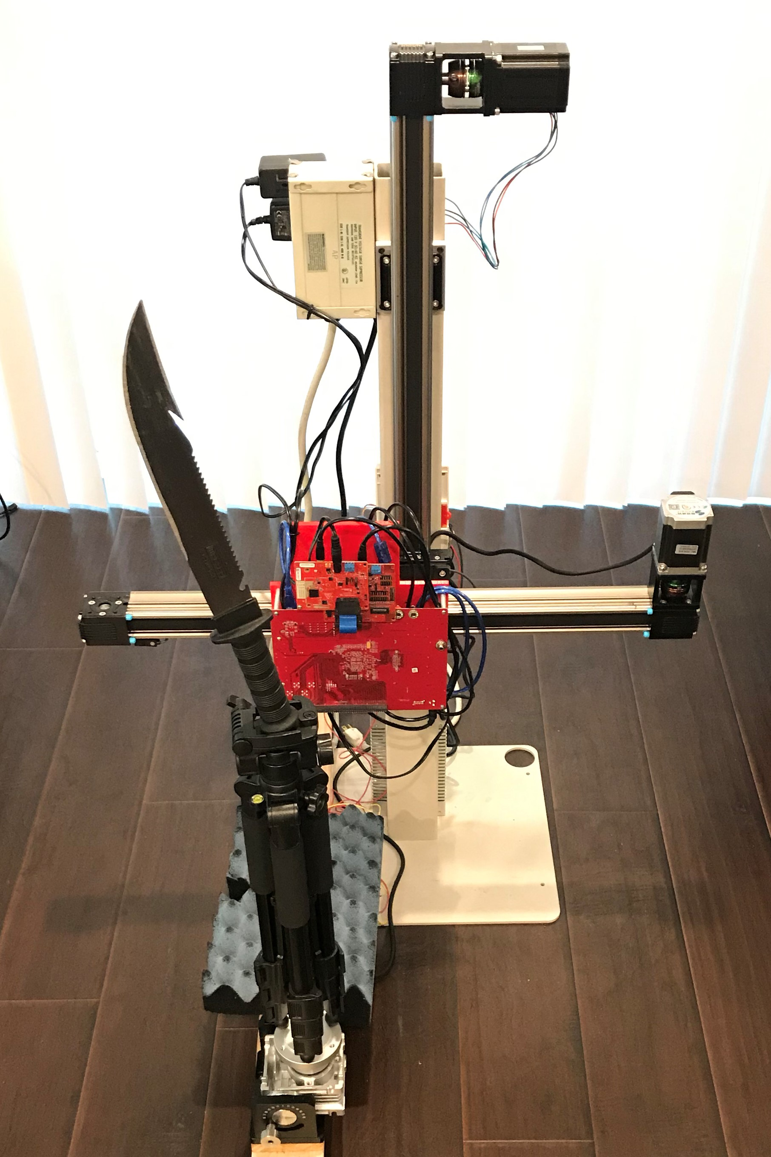
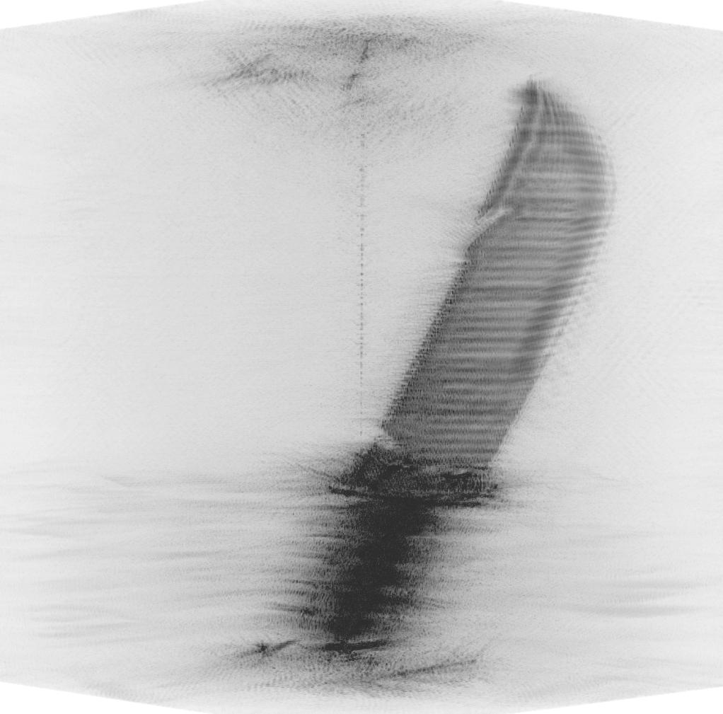
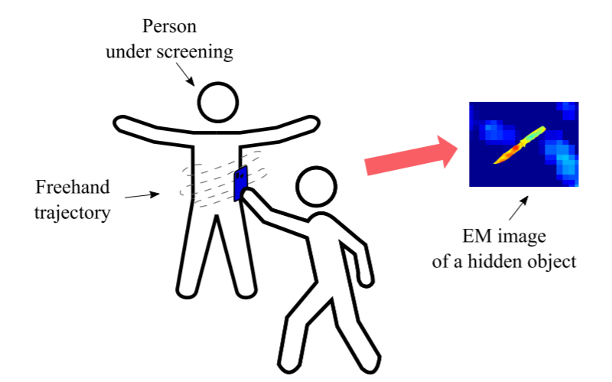



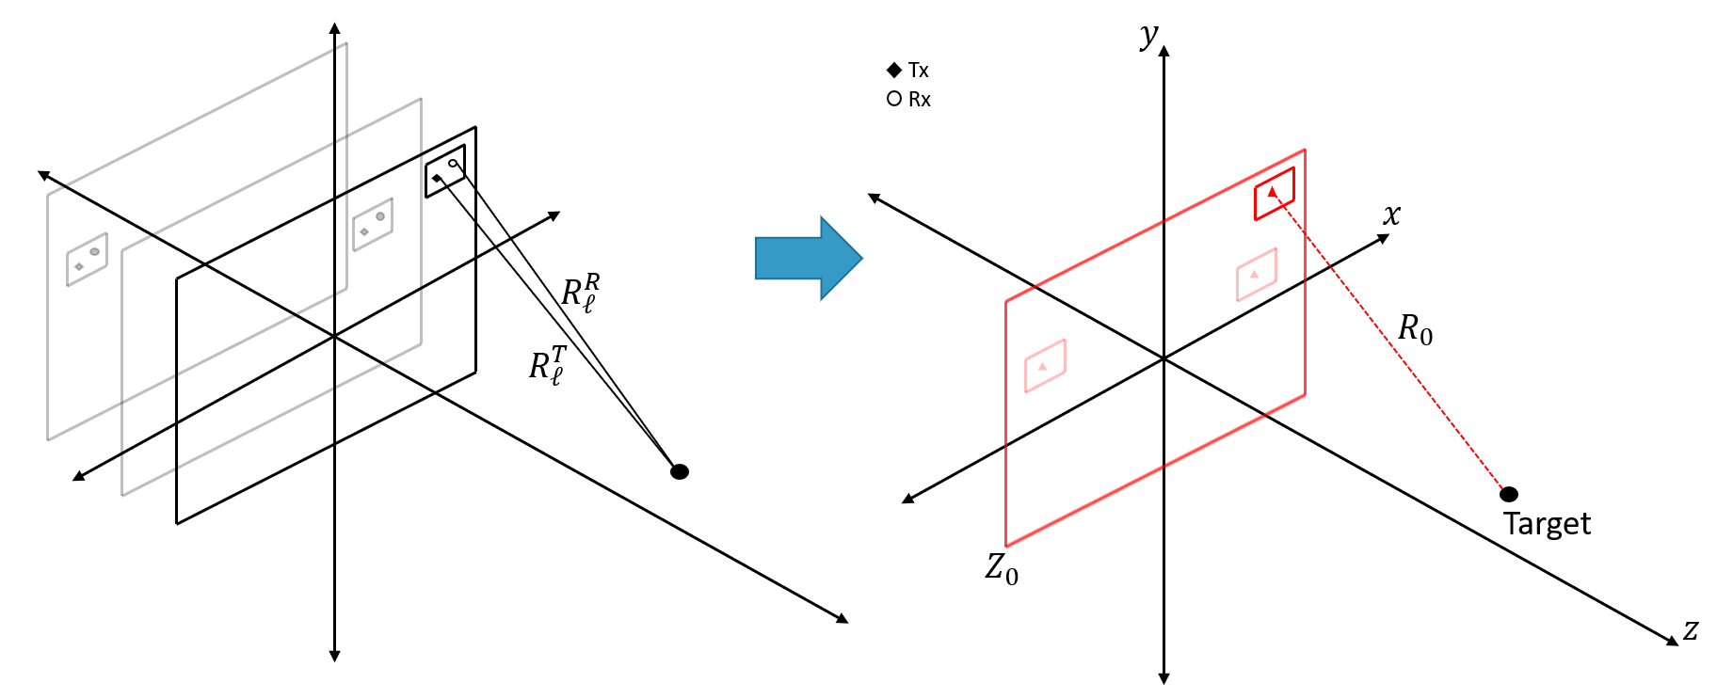
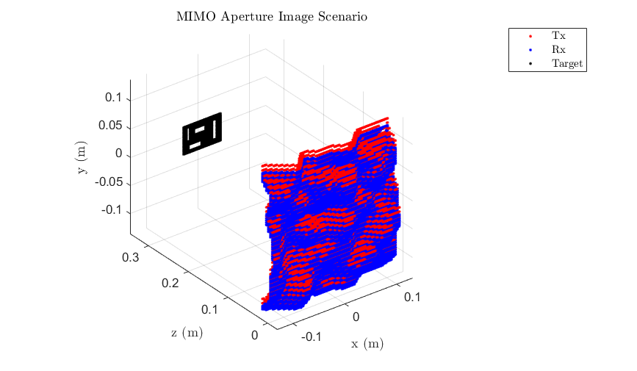
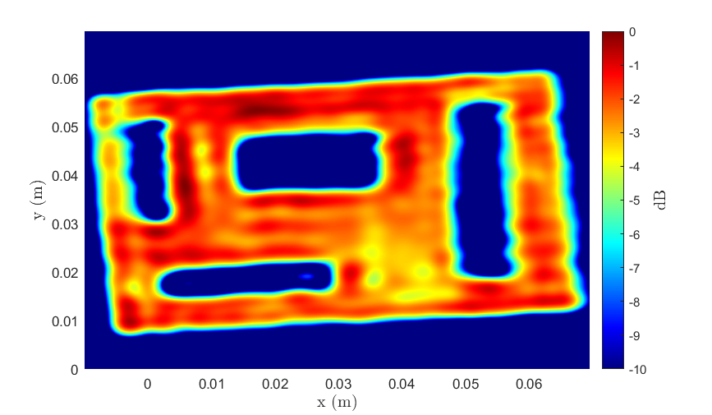
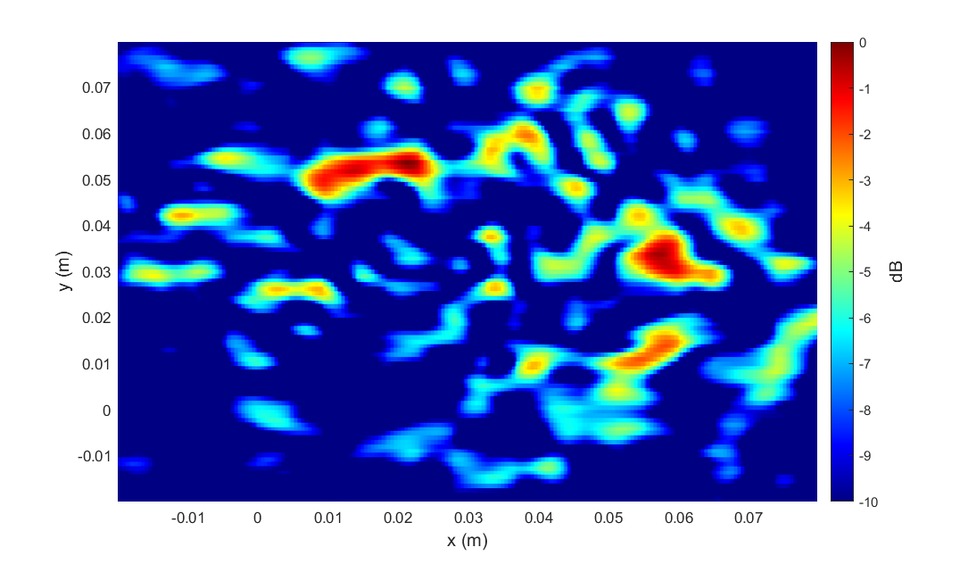
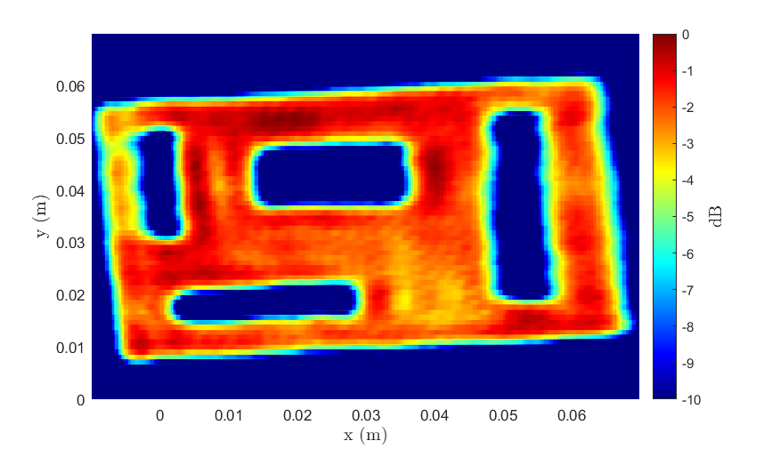
Tangent – Efficient Freehand Imaging
Traditional Array Imaging
Emerging Imaging Applications – Arbitrary Scanning Geometry
BPA – 3 hr
RMA – 1 s
Ours – 1 s

Slide 12
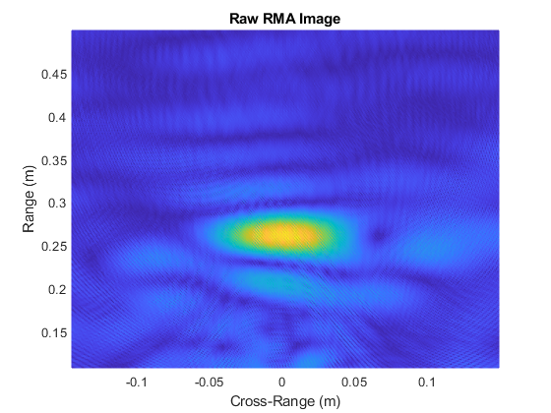
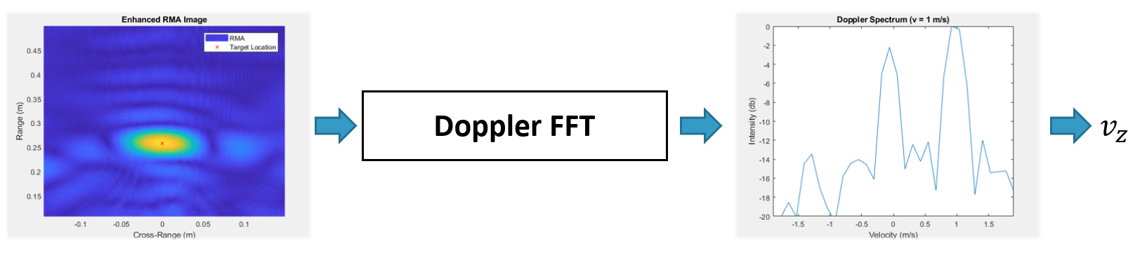
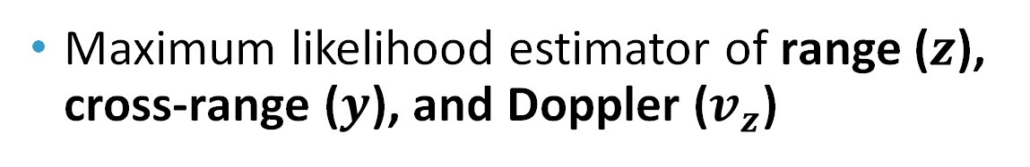
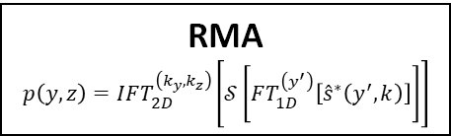
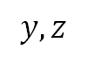
Conventional Feature Extraction
Maximum likelihood estimator of range ($z$), cross-range ($y$), and Doppler ($v_{z}$)
RMA
$$p\left(y,z\right)=IFT_{2D}^{\left(k_{y},k_{z}\right)}\left[𝒮\left[FT_{1D}^{\left(y^{′}\right)}\left[{\hat{s}}^{∗}\left(y^{′},k\right)\right]\right]\right]$$
$$y,z$$
1 m/s

Slide 13
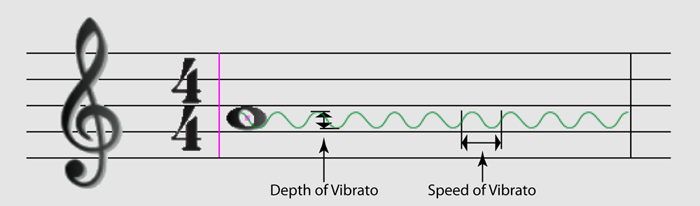
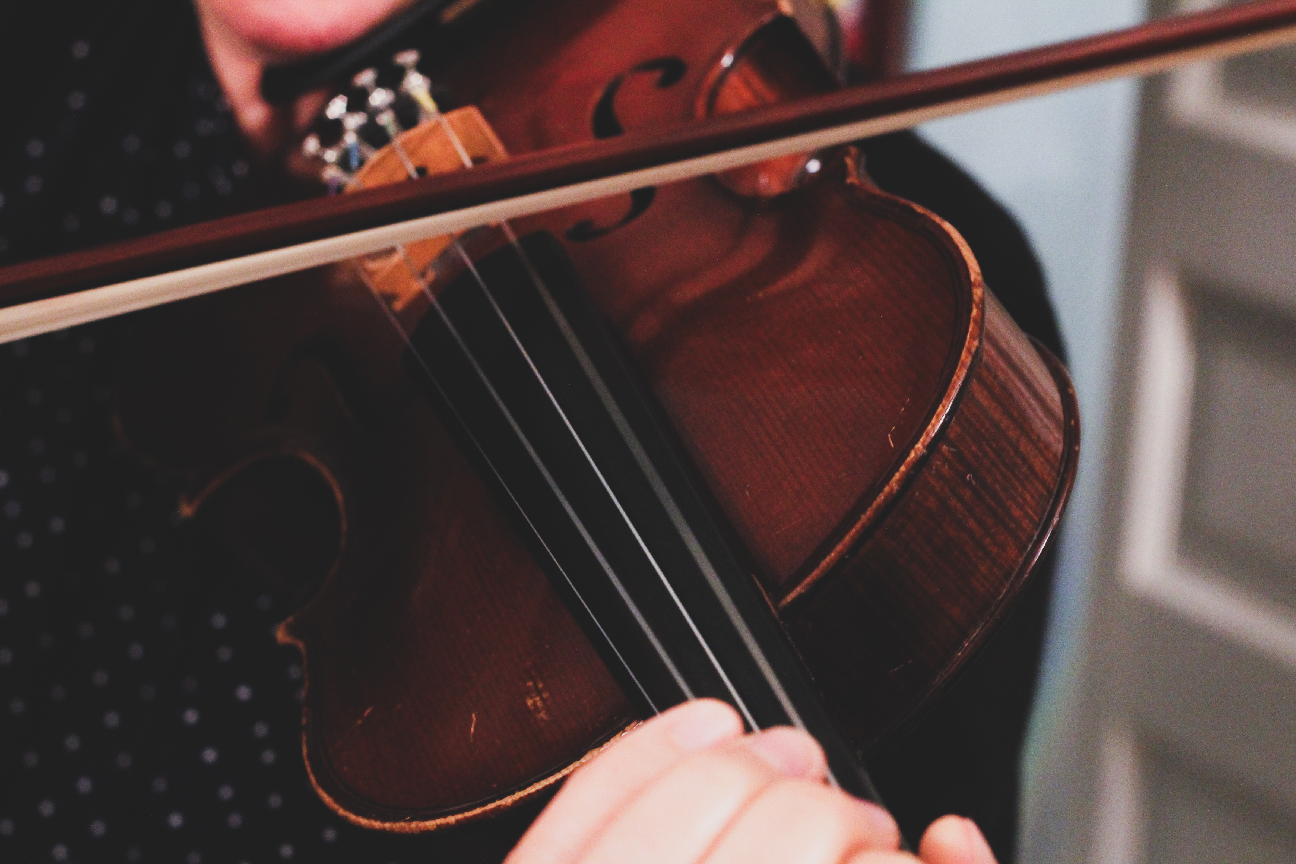
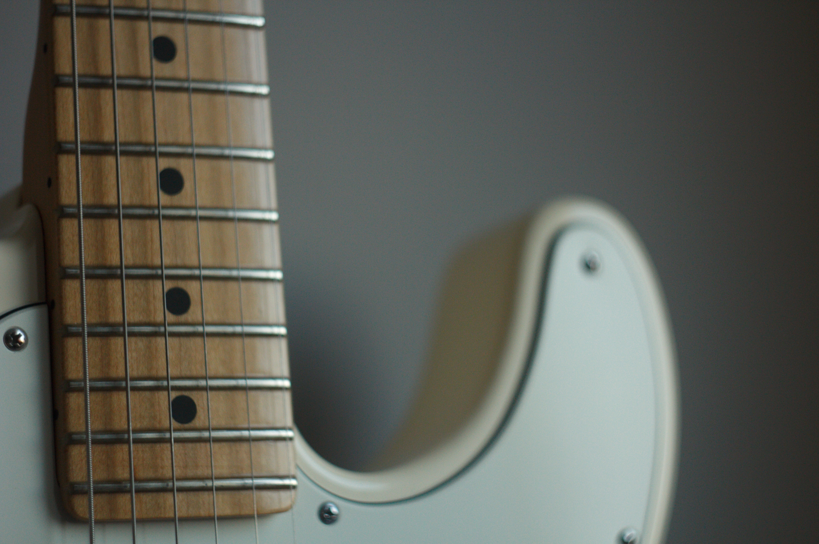
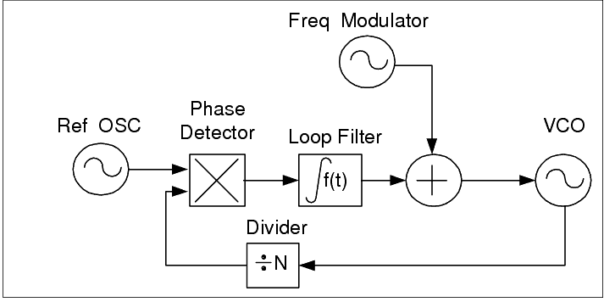
Music Theory for Engineers
Notes and Pitch
Pitch = fundamental frequency
Single frequency sinusoid with natural acoustic harmonics
Frets
Quantize finger placement on some stringed instruments
Vibrato
Frequency modulation applied to pitch
Thanks to listening-singing-teacher.com

Slide 14
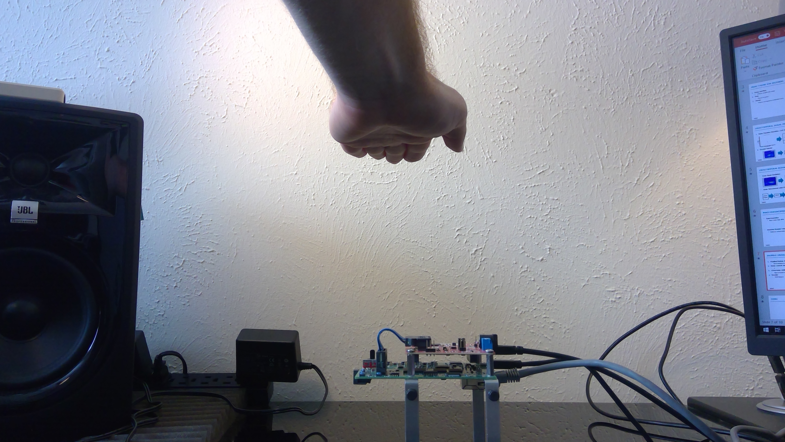
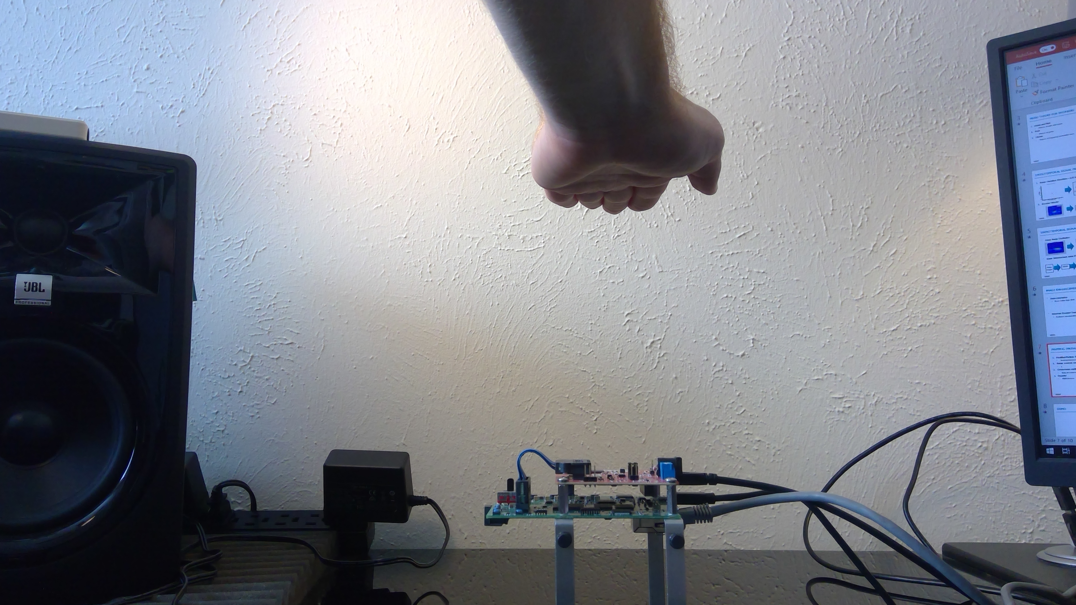
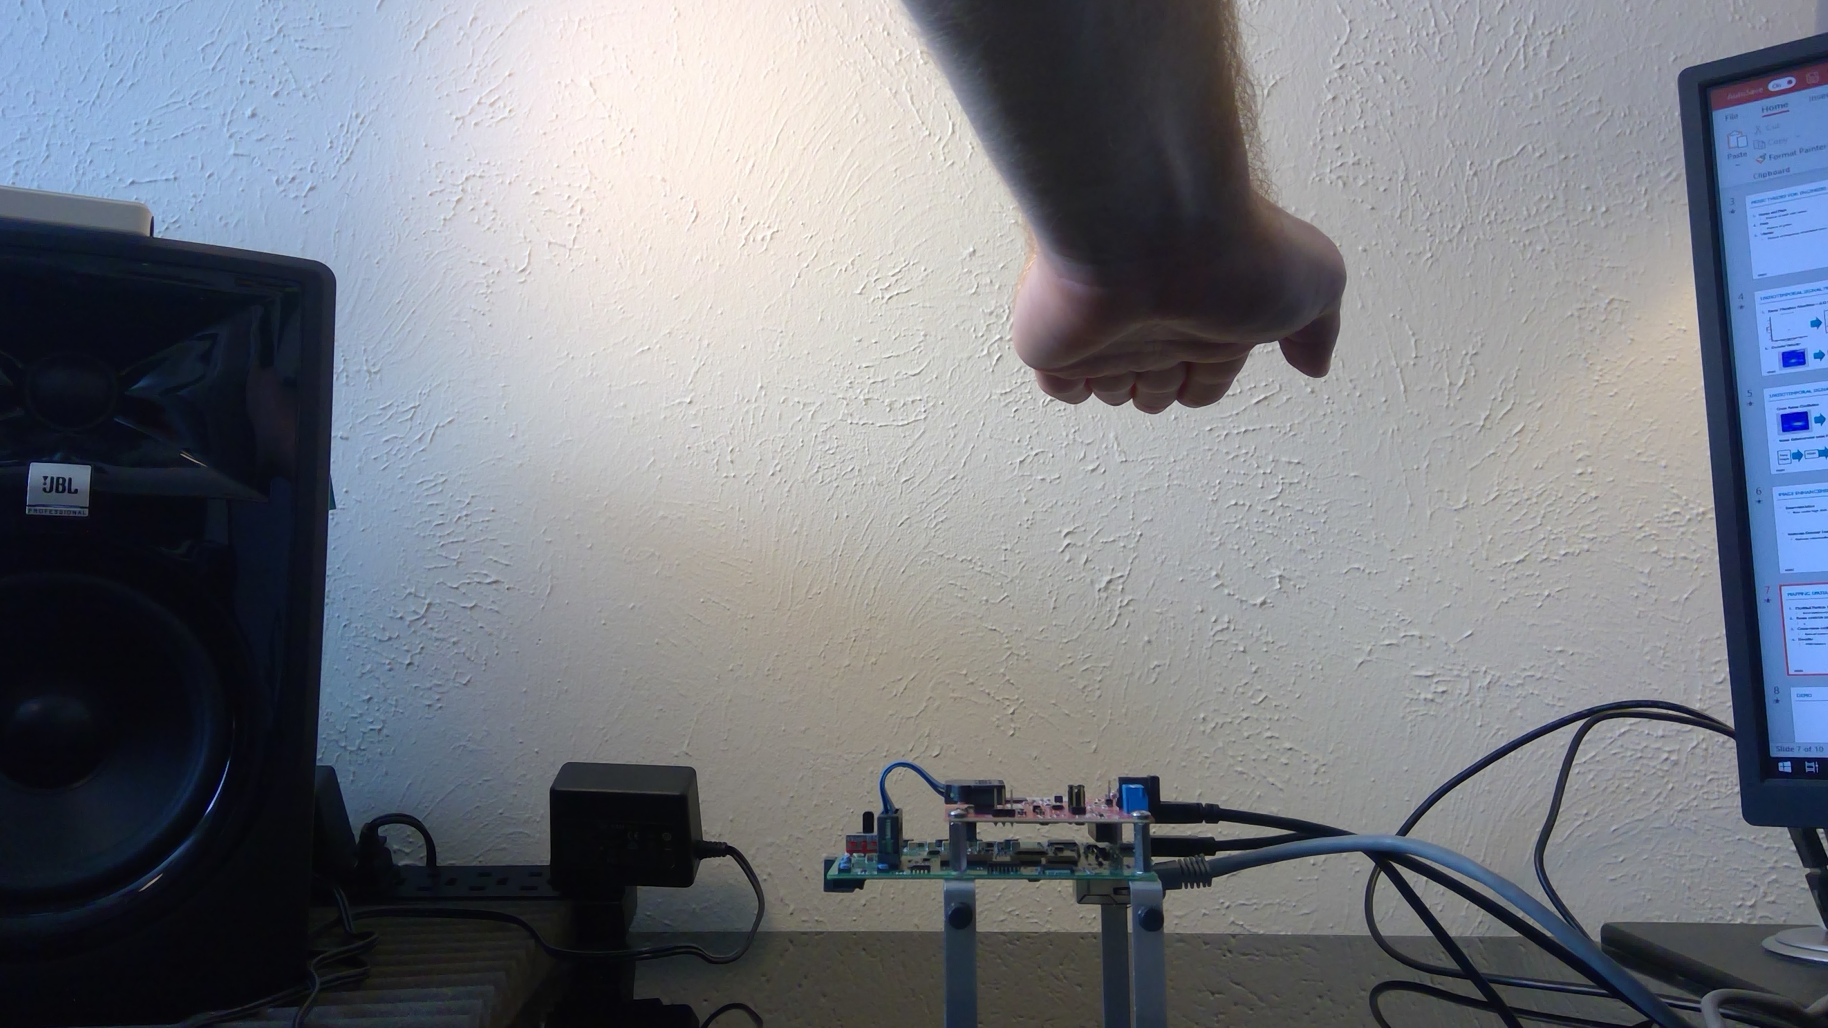
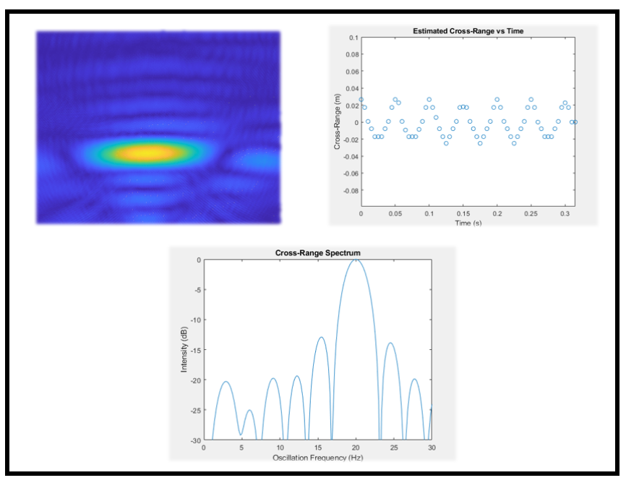
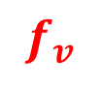

Mapping Radar Signatures to Music
Range → note selection
Vertical position to select desired note
Virtual fret quantize range into regions
Cross-range oscillation → vibrato
Doppler → MIDI parameter
$$f_{v}$$
$$cos⁡(2π×cos\left(2πf_{v}t\right)×t)$$

Slide 15

Simple Methods

Slide 16



Enhanced Feature Extraction
Enhance RMA images with neural processor prior to feature extraction
Feed extracted-enhanced features to computer vision tracking algorithm
Raw Images
Enhanced
Computer Vision Tracking Algorithm
Neural Processor

Slide 17

Spatial Super-Resolution
Image super-resolution emerging in ML / DL arena
Image upscaling akin to spatial super-resolution
Non-linear approach to leverage context / prior on images and signals
Can hybrid methods employ signal theory + ML for spatial and frequency super-resolution?

Slide 18


Tangent – Frequency Super-Resolution
Frequency super-resolution $⟺$ signal extrapolation
Proposed Solution: hybrid algorithms (signal processing + ML)

Slide 19


Tangent – Frequency Super-Resolution
Artificially / blindly improve spectral → spatial resolution
Raw 4 GHz Data
4 GHz → 8 GHz Bandwidth Extrapolation
Two scatterers separated by 2 cm
4 GHz bandwidth → 3.75 cm resolution
8 GHz bandwidth → 1.875 cm resolution

Slide 20



Spatial Super-Resolution FCNN
Image-to-image enhancement
Remove distortion, blur, noise, clutter, etc.
Improve subsequent feature extraction
Train on real data from human hands + synthetic simulated data

Slide 21

Particle Filter Tracking
Particle filter (condensation algorithm) tracking
Computer vision approach
Can handle sudden movements and non-linear dynamics
Leverage Doppler for dynamic particle drift weighting
Dynamically update “importance” weight of new measurement

Slide 22

Enhanced Methods

Slide 23


Results – Ground Truth + Simple Methods

Slide 24


Results – Particle Filter + Doppler
FCNN Improves Doppler SNR

Slide 25

Results – Ground Truth + Simple Methods

Slide 26




Hardware & Software Implementation
Hardware Setup
TI 77 GHz mmWave MIMO-FMCW Radar
TI High Speed Data Capture Card
Software Implementation
MATLAB Interface
Custom C++/MEX software stream data from TI radar to MATLAB in real-time

Slide 27

Results – Simple Methods
Content available on IEEE Xplore

Slide 28

Results – Enhanced Methods
Content available on IEEE Xplore

Slide 29

Conclusions
Radar Musical Instrument
Signal processing + machine learning + computer vision = hybrid-algorithms
High-fidelity tracking framework without any optical sensor
Surpass theoretical spatial resolution limitations
Why APL?
Intersection of research and defense industry
Impactful work on critical challenges
Rapid learner & contributor
Solving new problems and “owning the problem”

Slide 30

Music Demo
Content available on IEEE Xplore

